Slide 1




CLOSE-READING of LINKED DATA
Anne Chardonnens, Ettore Rizza & Seth van Hooland
Notes:
Titre

Slide 2
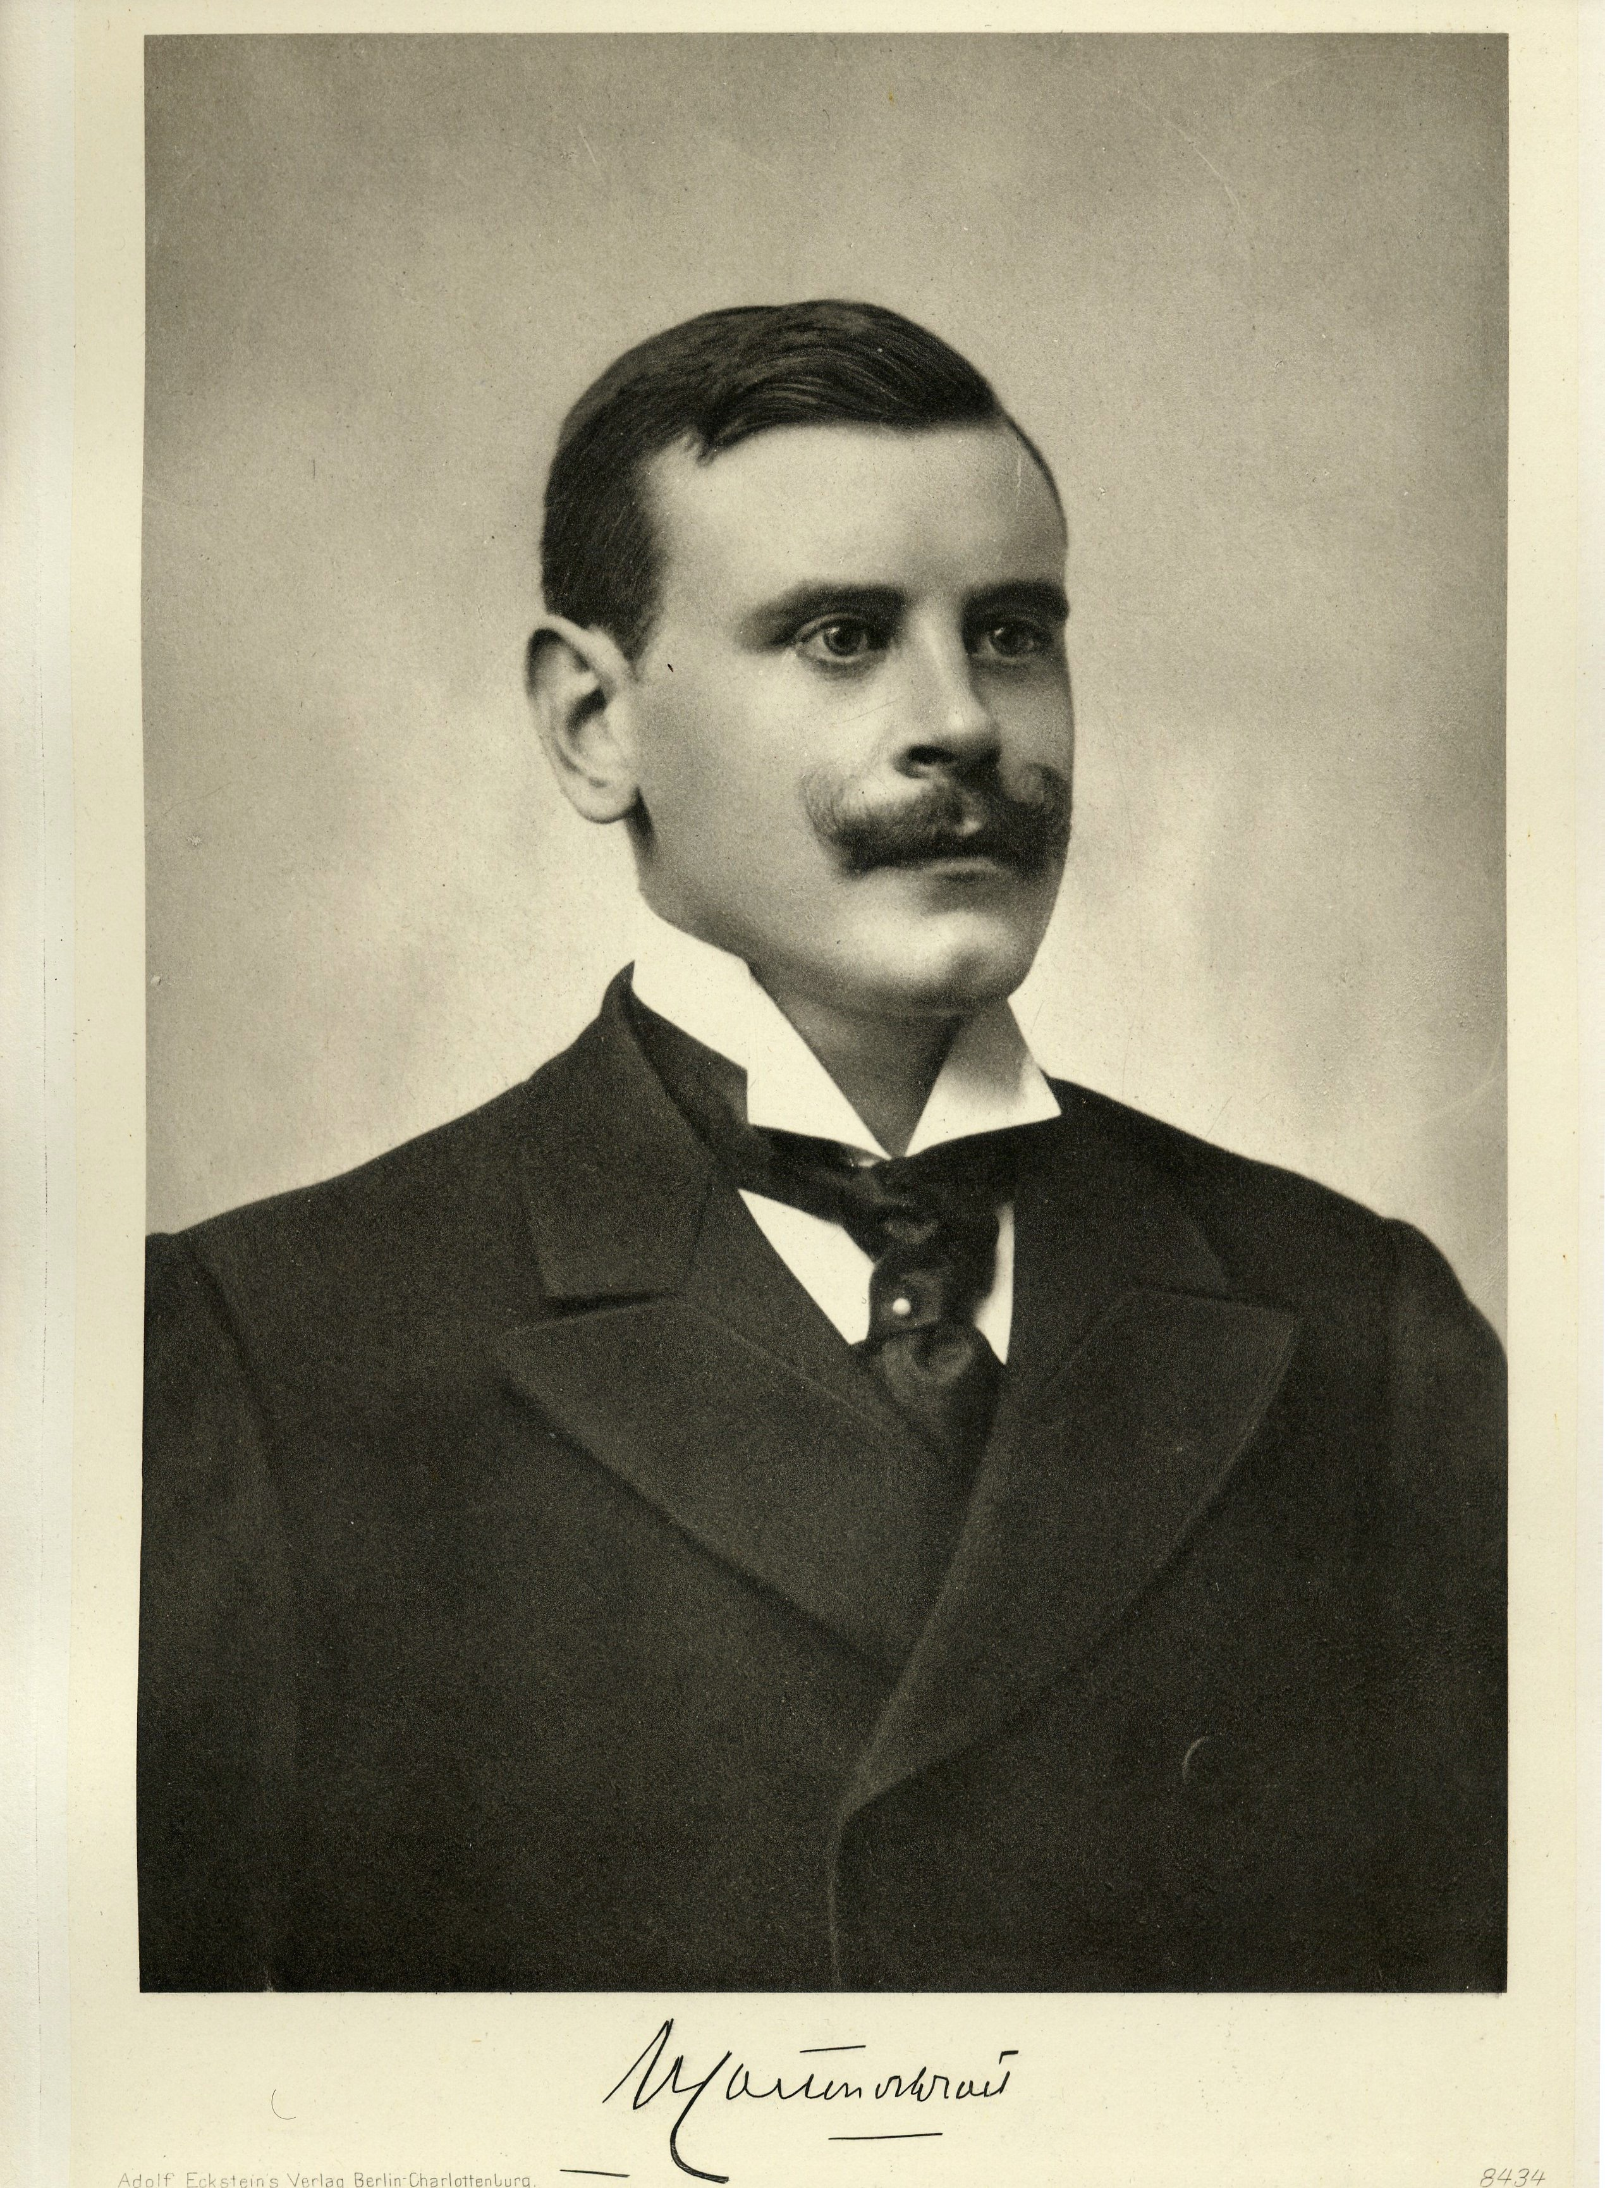
Henry CARTON DE WIARt

Slide 3

CLOSE-READING

Slide 4
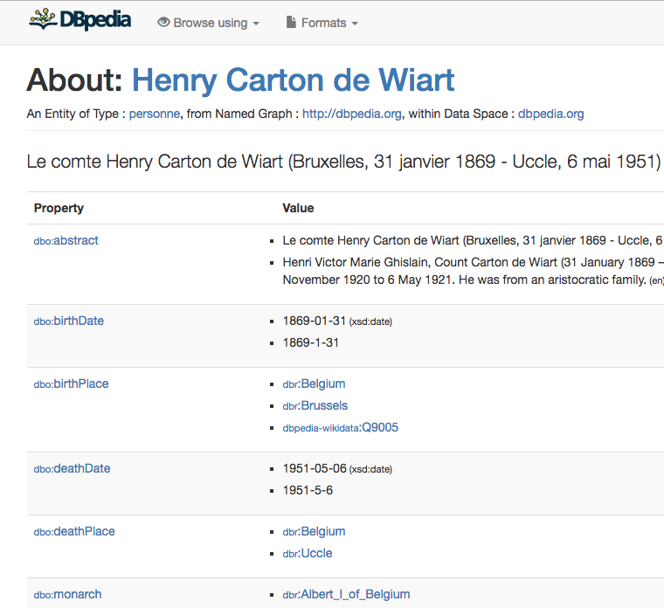
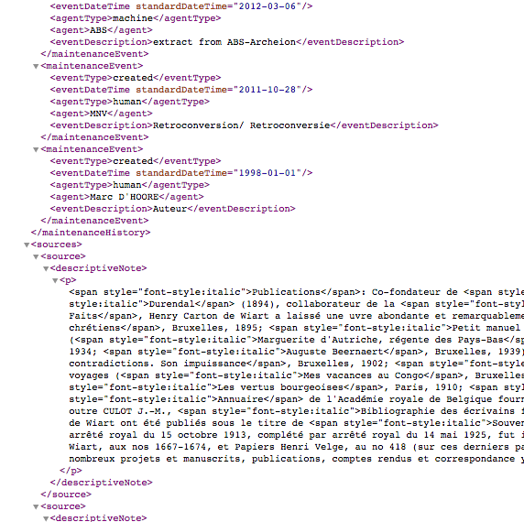
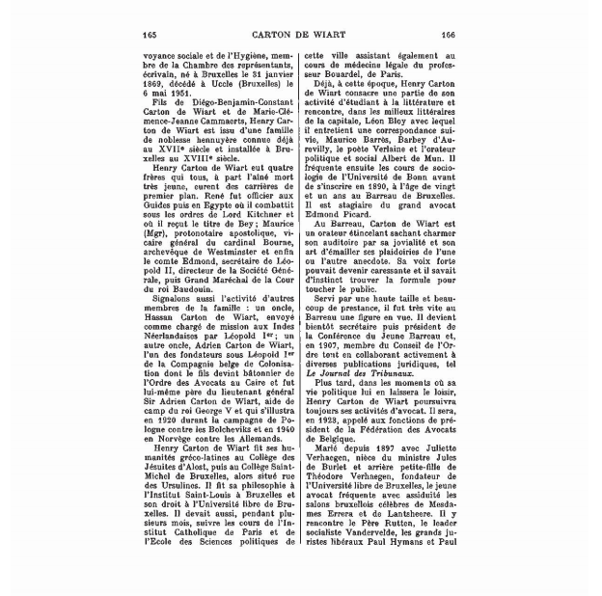
CONTinuum

Slide 5
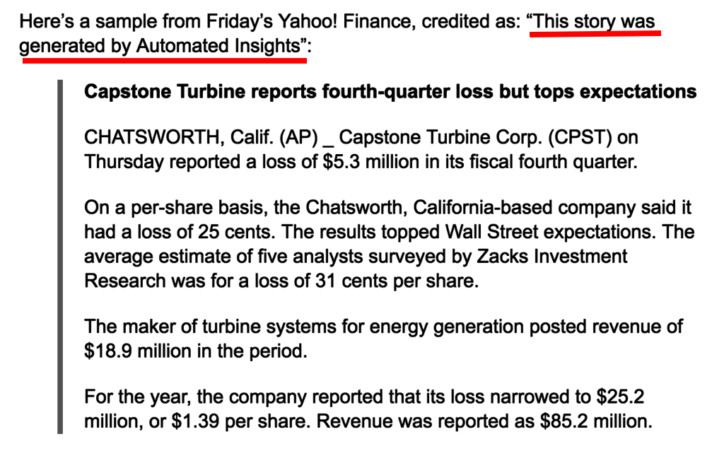

Robots can write short papers based on data
Image (30.04.2018):https://lod-cloud.net/)

Slide 6

Alex, the robot-biographer
It can send queries on the web (API, SPARQL…)
It can read structured formats (XML, JSON, Turtle...)
It can write a short text from structured data

Slide 7
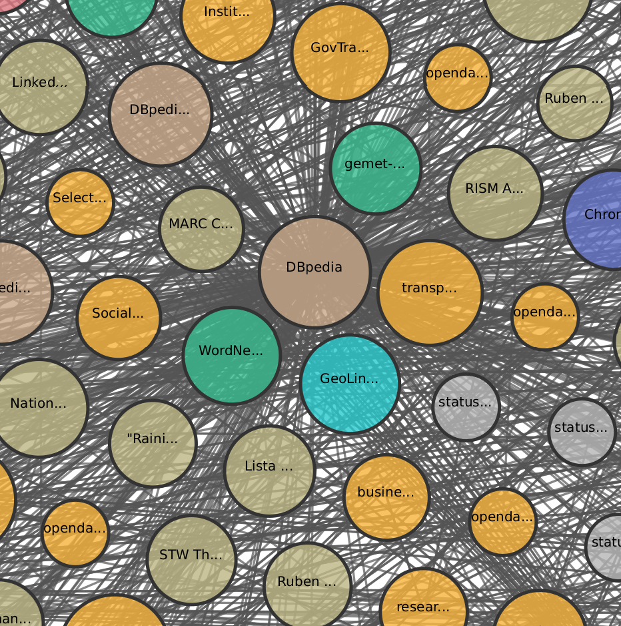
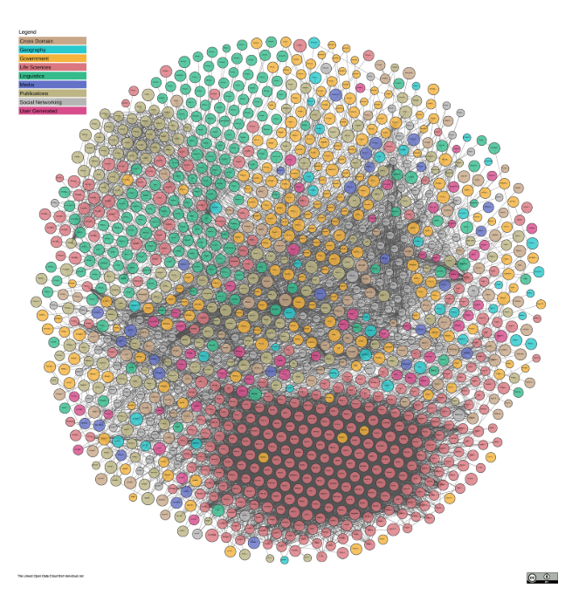
A robot walk in the Linked open data cloud
Image (30.04.2018):https://lod-cloud.net/)

Slide 8
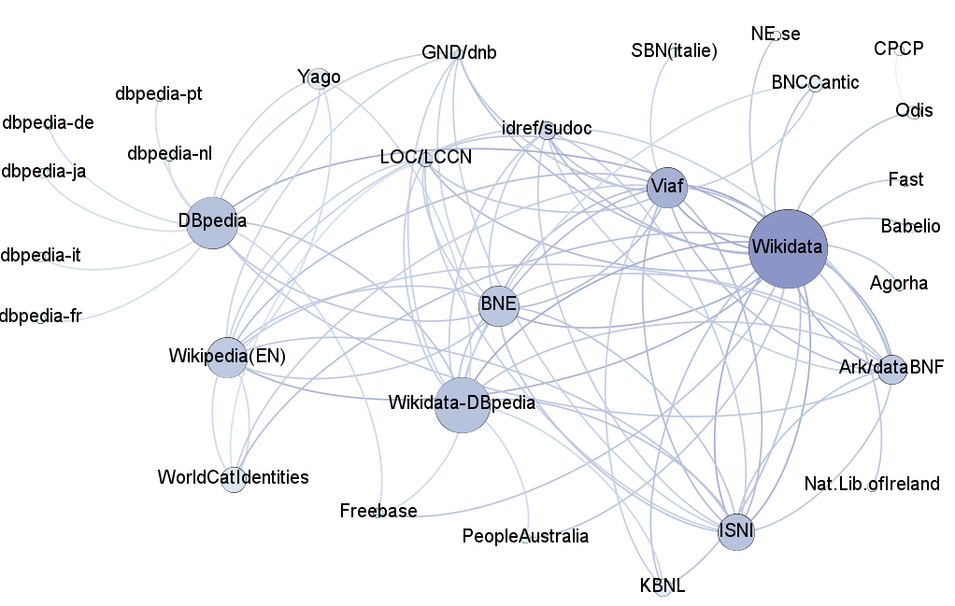
A robot walk in the LOD cloud
Image (30.04.2018):https://lod-cloud.net/)

Slide 9
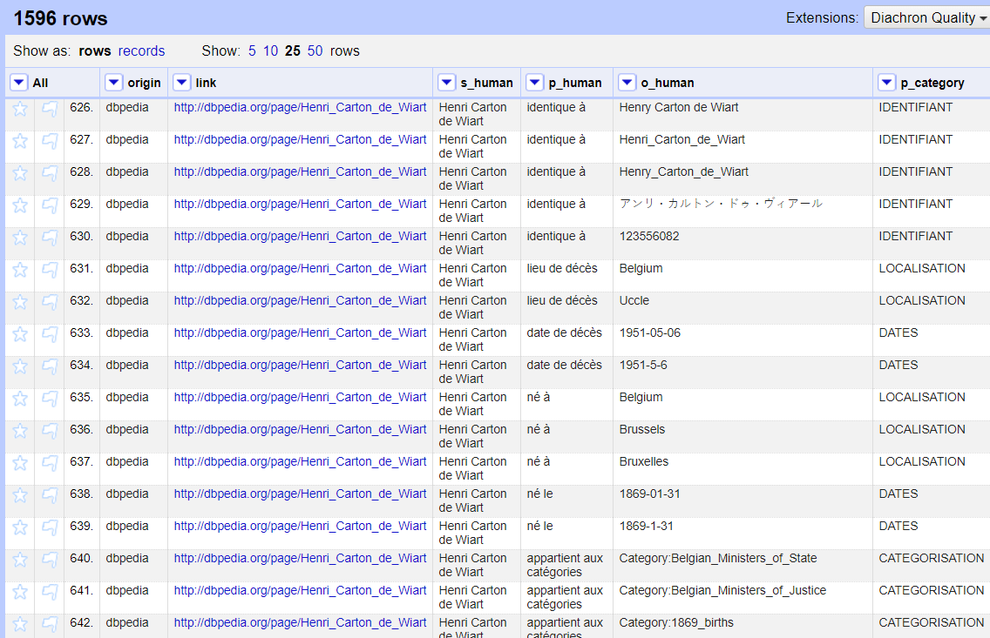
A lot of triples often useless or redundant
Image (30.04.2018):https://lod-cloud.net/)

Slide 10
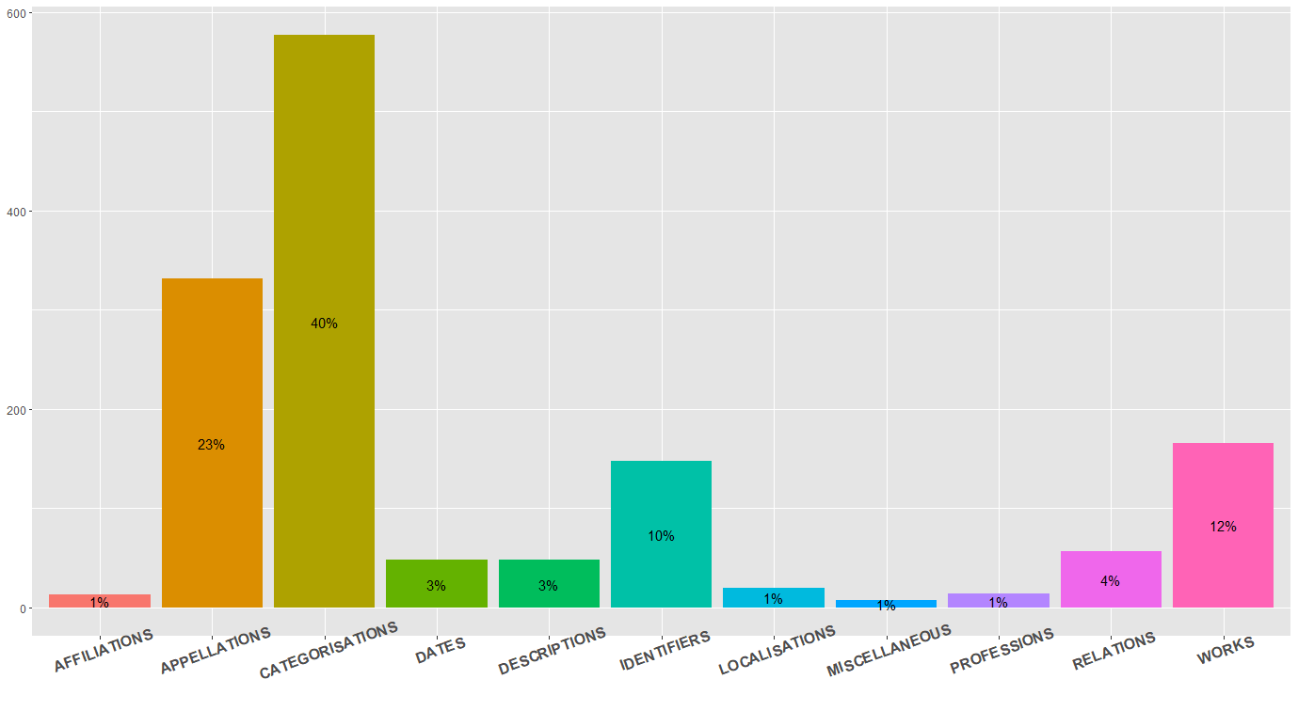
broad categories of RDF properties
Image (30.04.2018):https://lod-cloud.net/)

Slide 11
A “portrait-robot” based on Wikidata and Dbpedia EN-FR-NL
Henri or Henry Carton de Wiart (first name: Henry or Henri, name: Carton) is a French-speaking Belgian writer and politician, member of the Catholic Party or cdH. He was born on January 31, 1869 in Brussels and died on May 6, 1951 in Uccle. He served as Prime Minister of Belgium from 20 November 1920 to 16 December 1921, replacing Leon Delacroix and replaced by Georges Theunis.
He was a member of the House of Representatives (unknown period) and of the Royal Academy of French Language and Literature of Belgium (from August 9, 1920 to his death, where he was replaced by Hislaire Duesberg). His monarch was Albert the Ist. He belonged to a coalition Catholic Party, PLP, POB. He lived in Rue de la Loi and his residence was "16".
He had as predecessors Albert Lilar, Hendrik Heyman, Henry Jaspar, Leon de Lantsheere, Leon Delacroix and Paul De Groote. He had as successors André_Dequae, Edmond_Rubbens, Emile_Vandervelde, Georges_Theunis, Ludovic_Moyersoen and Paul De Groote.
He had some connection with Liege, Leopold III, Marcel Thiry, the Walloon Movement, Prosper Chicken, the Royal Question, the Wehrmacht, with several legislatures of the House of Representatives, several governments, with Albert Houtart, Gaston Eyskens, Adolf Daens, Jean Duvieusart, Edmond Carton de Wiart, with the Collège Saint-Michel, the moral classes, the circle Leo XIII... He is on the lists of or in the categories of Belgian Prime Ministers, Ministers of Justice, Interior, State, Education in French-speaking Belgium, count, member of the Royal Academy, former deputy, writer of the nineteenth and twentieth century, French writer…
Image (30.04.2018):https://lod-cloud.net/)

Slide 12
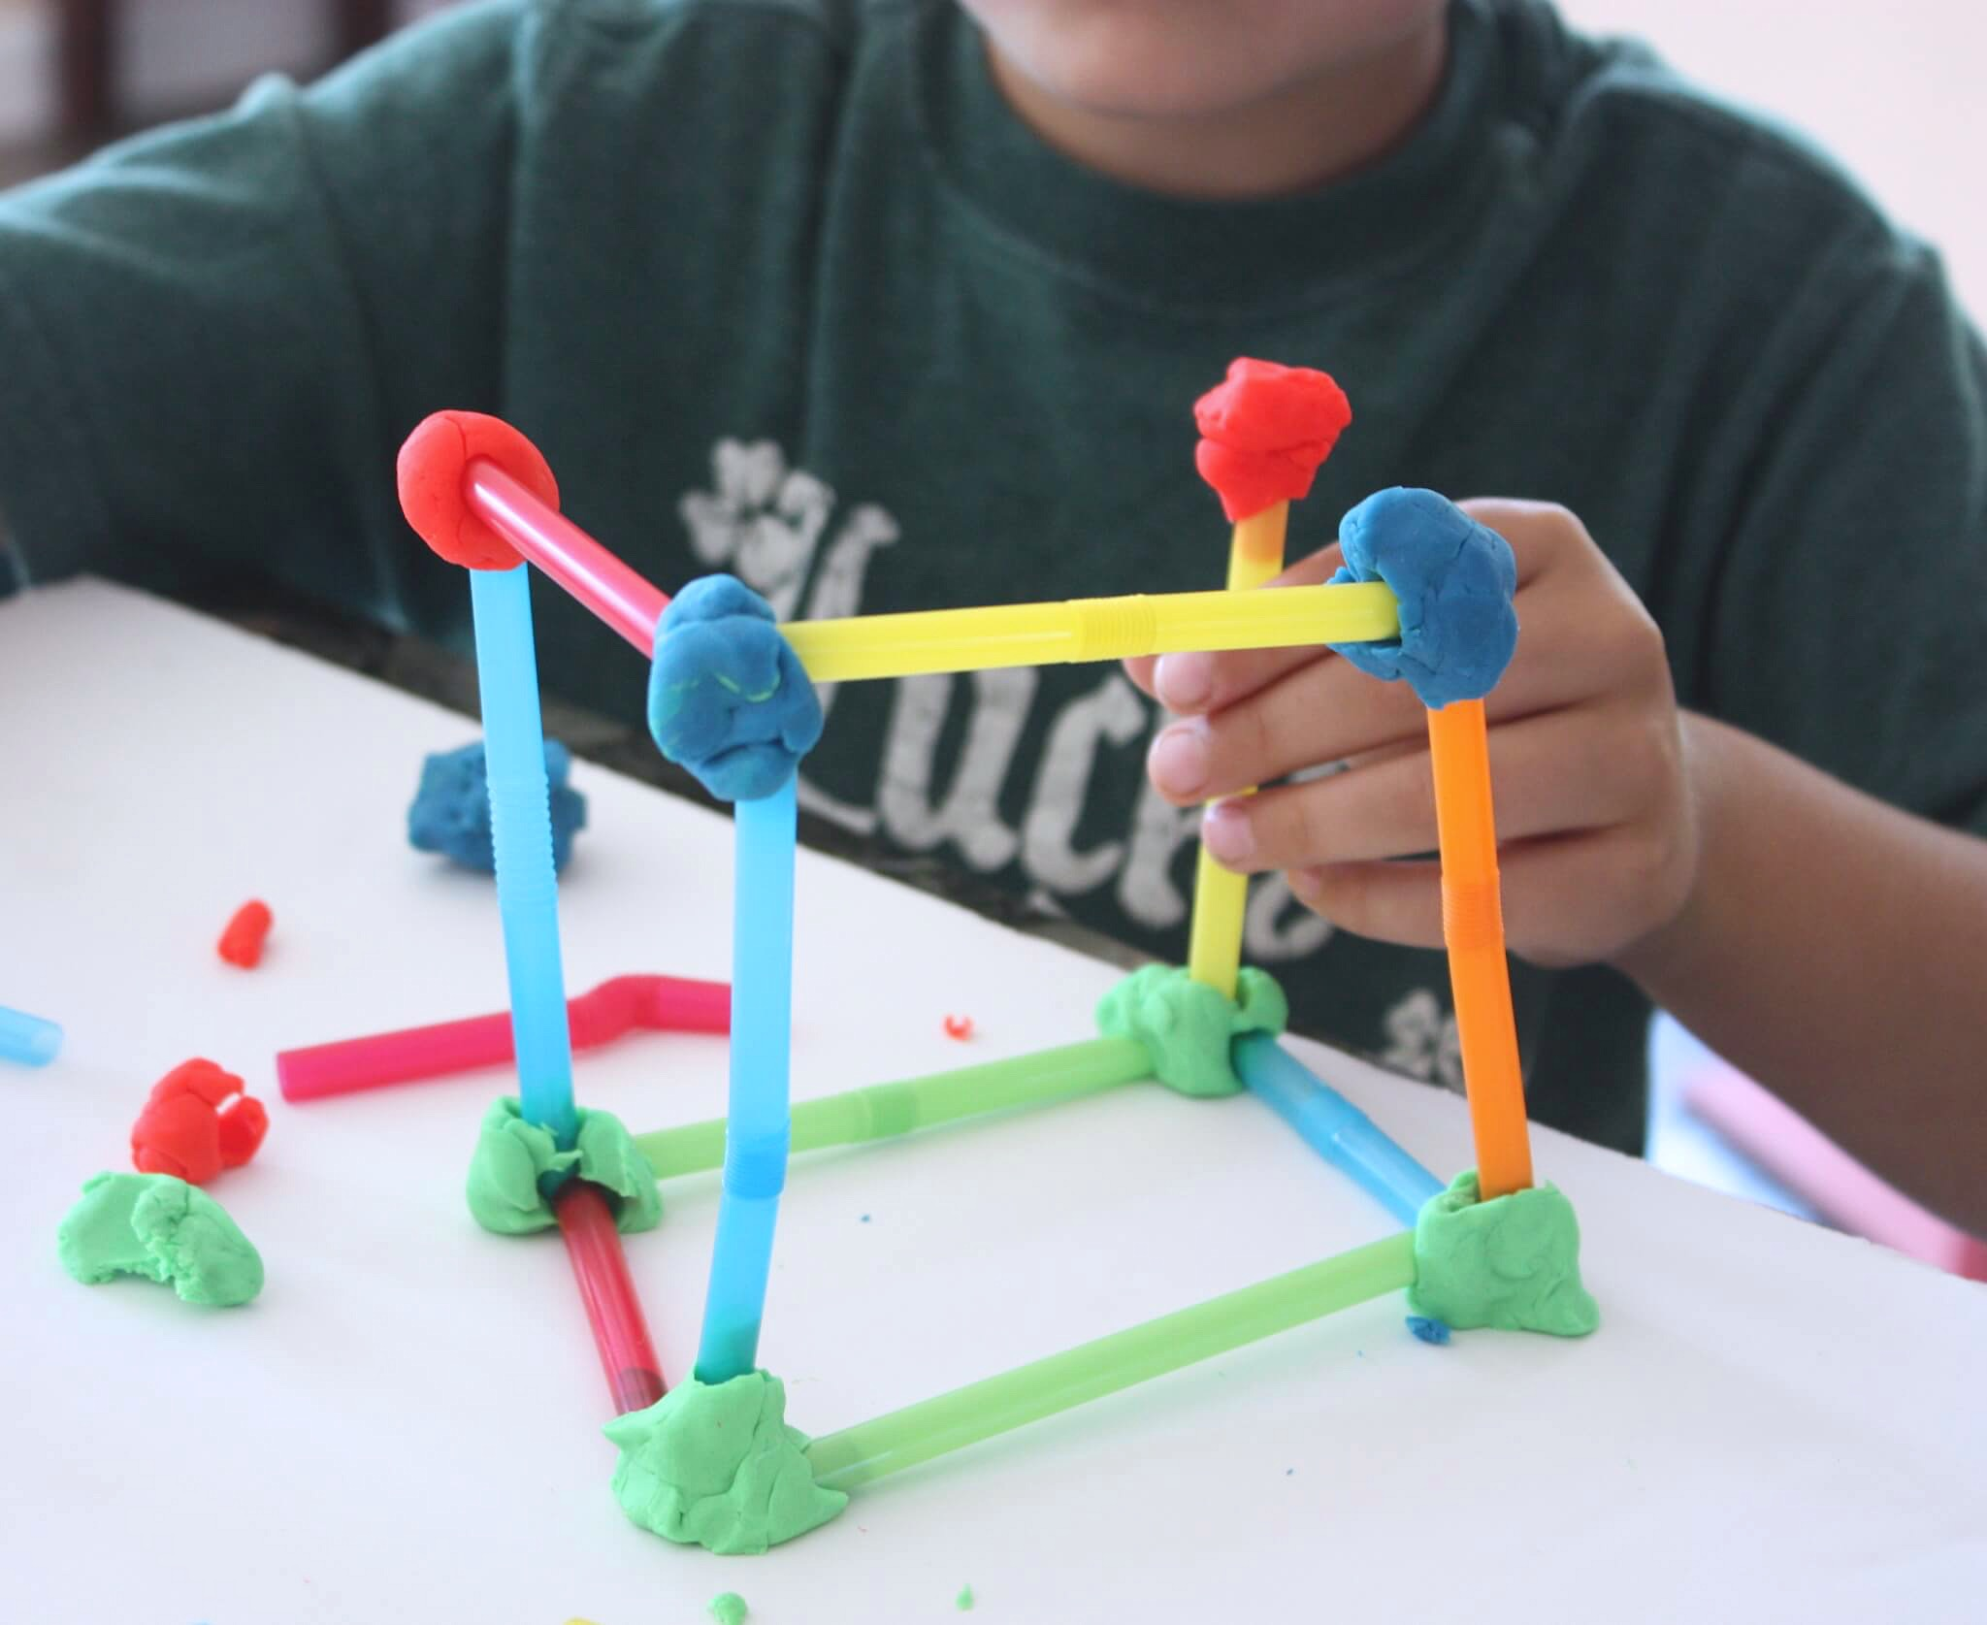
MANUAL “triplification”

Slide 13
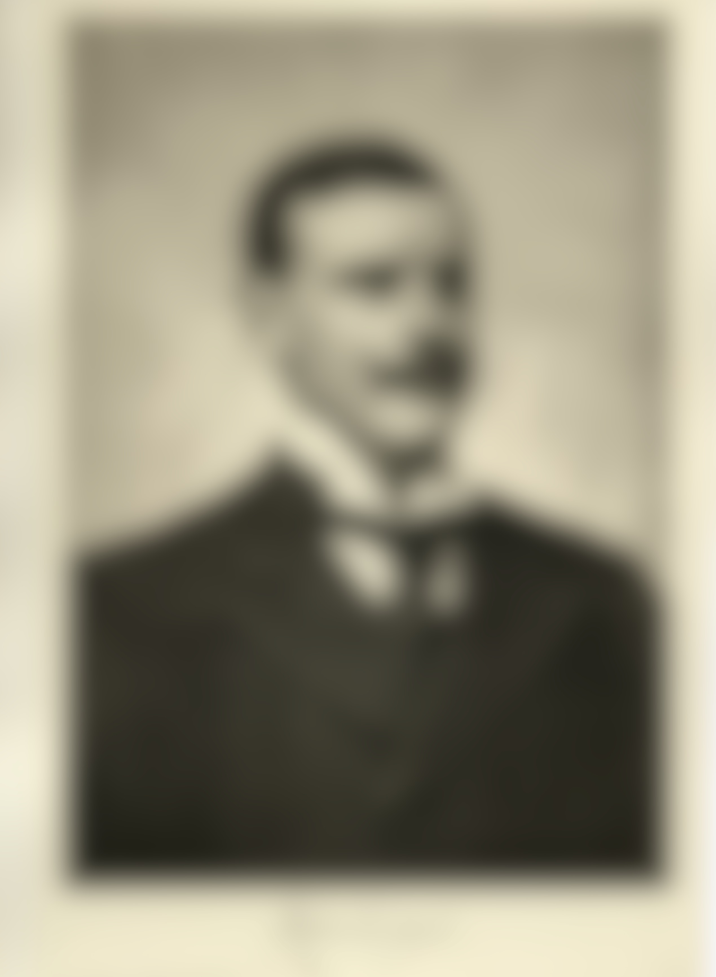
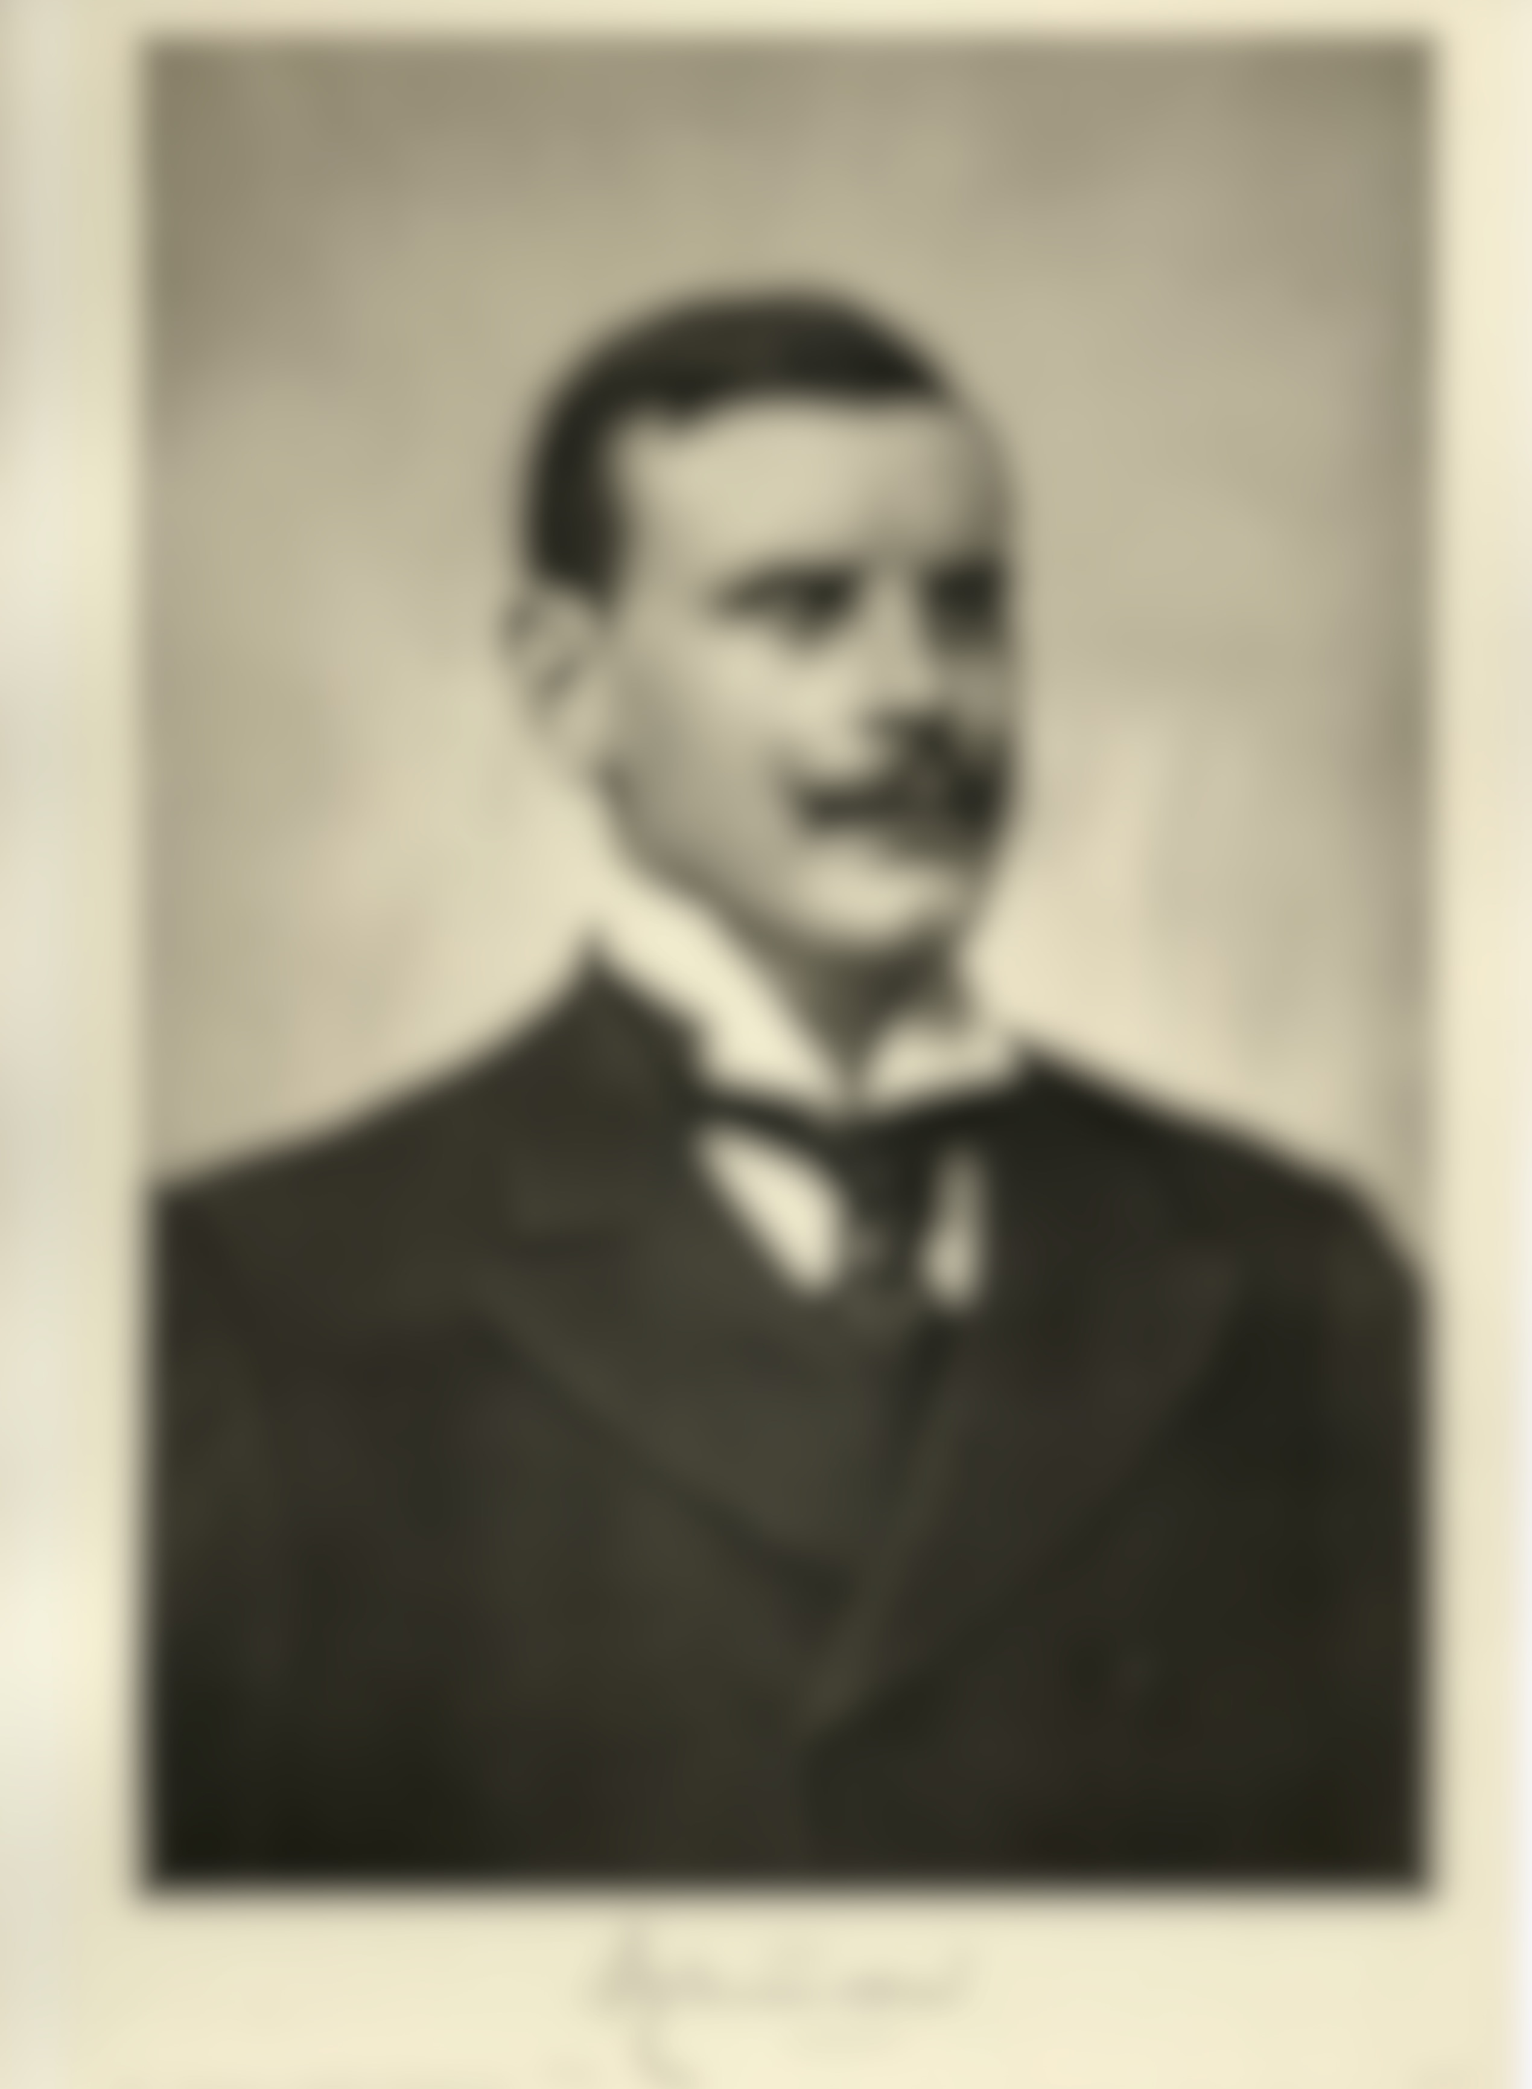
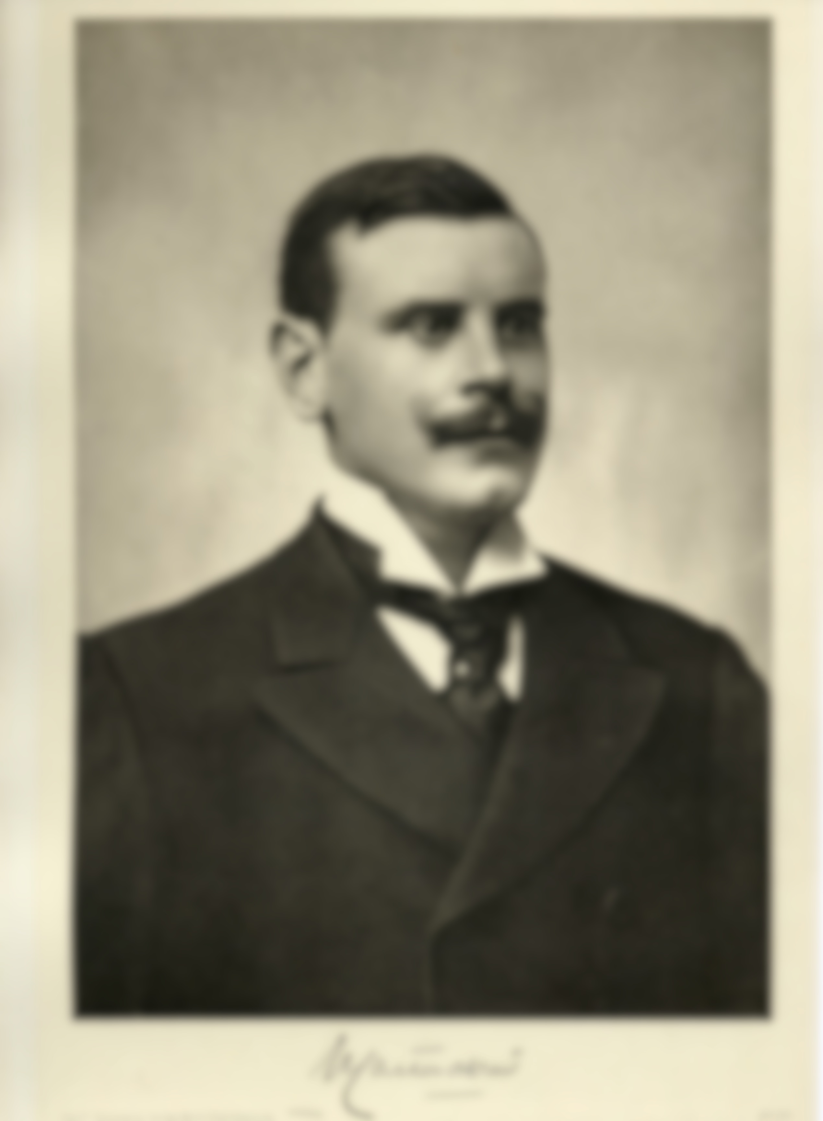

LIMITS

Slide 14
THINK ABOUT
Data
completeness
granularity
RDF structure
reification
deductive logic
Vocabulary
granularity
long tail

Slide 15
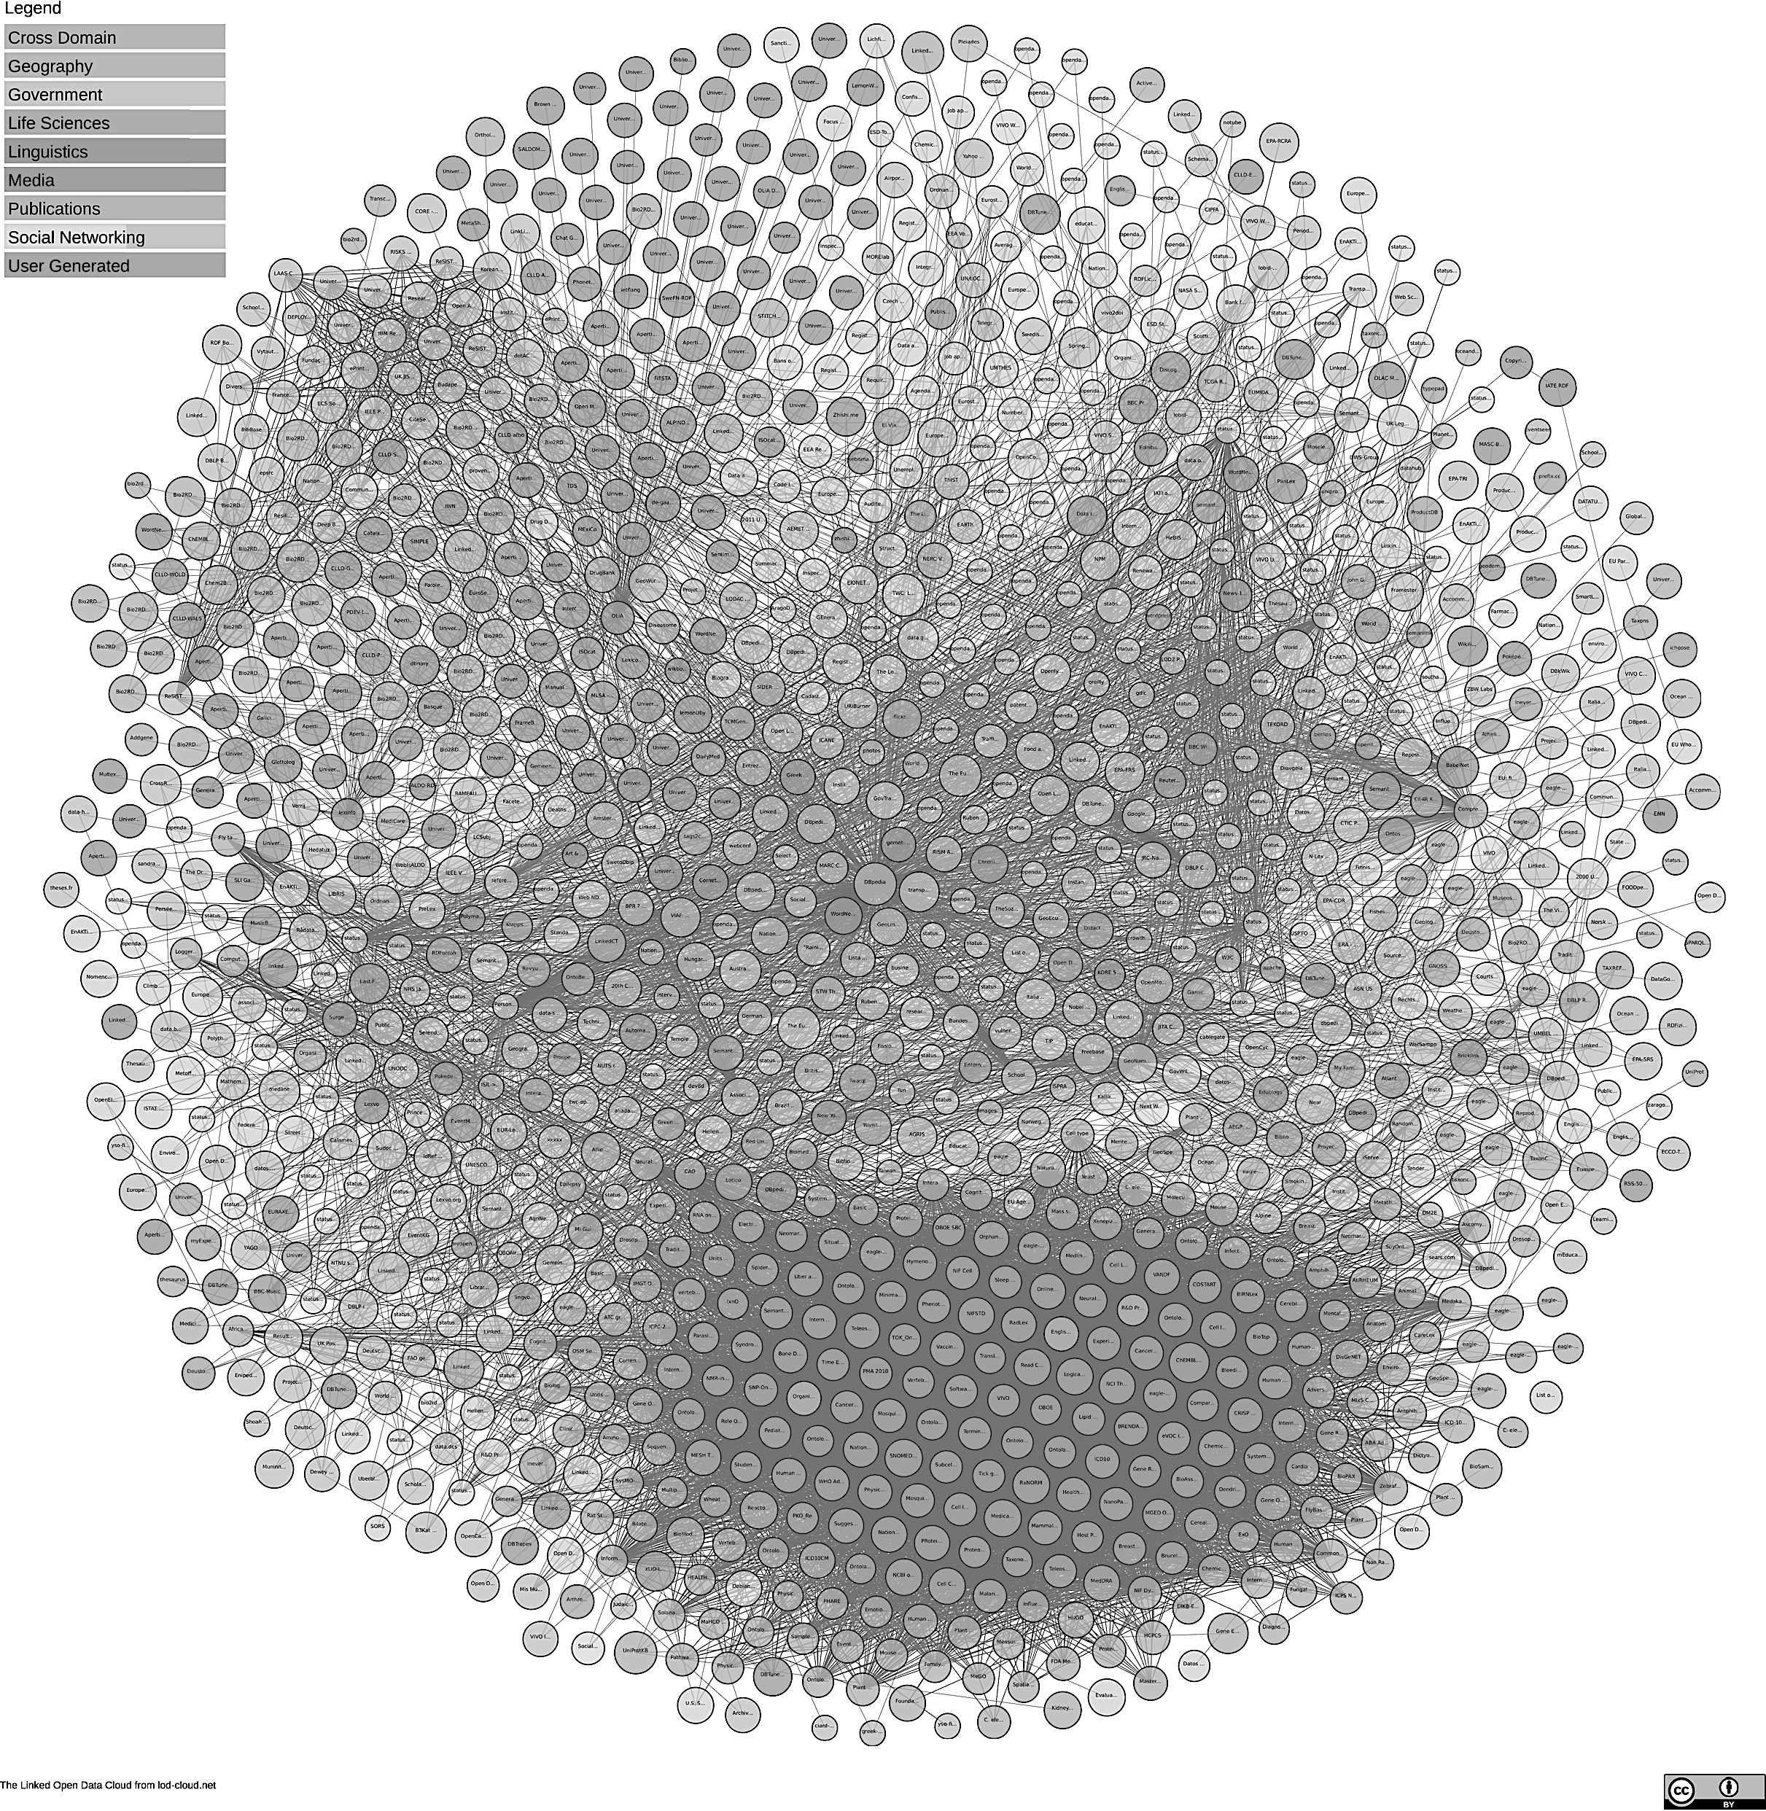



What IF…
Image (30.04.2018):https://lod-cloud.net/)

Slide 16

Conclusion
The biographical information contained in the LOD cloud is quite poor and redundant (at least for Carton de Wiart)
But we could add a lot of information pretty easily
Creating our own RDF files or enriching Wikidata?
Next steps: continue the experiment with a larger sample of entities (other people, organizations, events ...).

